Slide 1
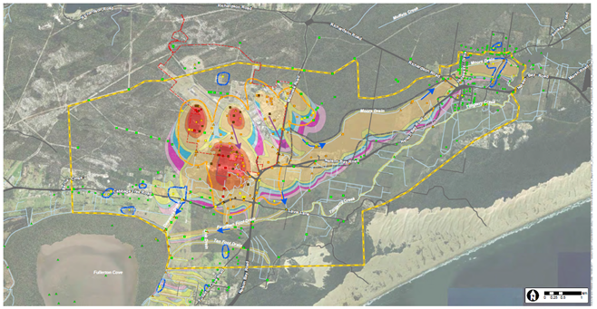
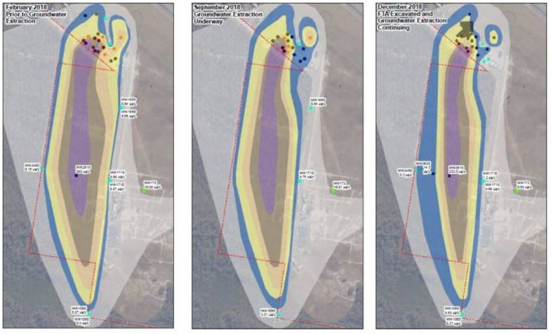
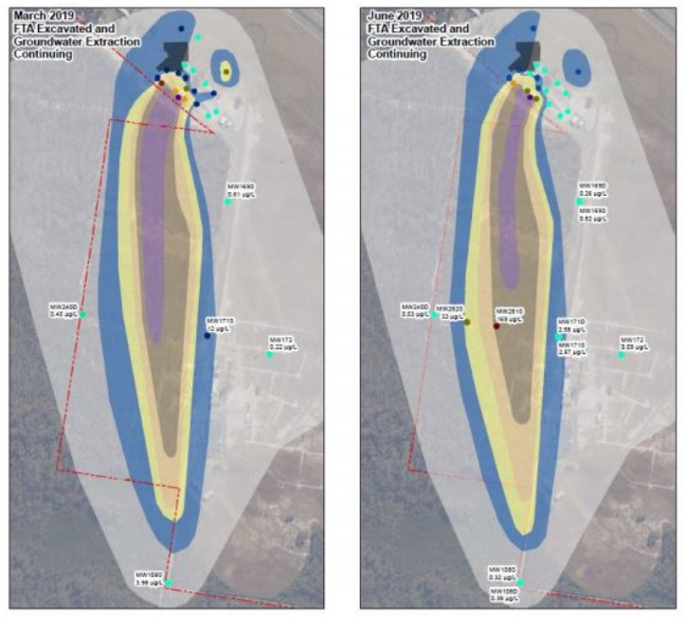

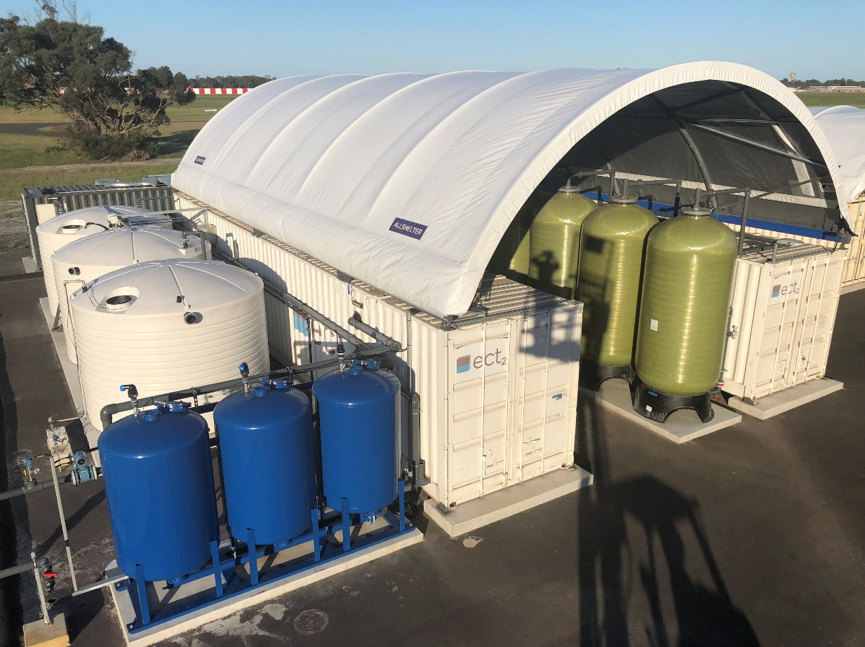
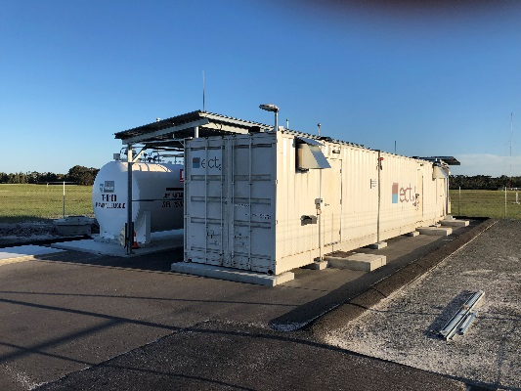
Ion Exchange Groundwater Treatment System Addresses PFAS Contamination in Former Fire Training Area at an Australian Air Base
Sarah Shipley & Steve Woodard, ECT2 | sshipley@ect2.com, swoodard@ect2.com
Background
Historical use of AFFF at RAAF Base Williamtown in NSW, Australia has resulted PFAS contamination of groundwater, which migrates off base. After defining the nature and extent of PFAS contamination, the Australian Department of Defence retained ECT2 to supply and operate a PFAS water treatment system that would manage contaminated groundwater at the former Fire Training Area (FTA). The primary PFAS compounds found at the Site are PFOS and PFHxS at combined concentrations above Australia’s HBGV of 0.07 µg/L. The SORBIX RePure regenerable resin system was selected for full-scale application, based on system performance and a lower overall lifecycle cost than GAC.
Approach and Results
The PFAS removal system includes: Sand filters to remove iron and solids Back-washable pretreatment IX resin to remove organic compounds and colloidal iron Two parallel trains of lead-lag SORBIX RePURE IX resin vessels for PFAS removal Two parallel trains of lead-lag SORBIX PURE polish IX resin vessels to enhance short-chain PFAS removal A centralised resin regeneration system to remove PFAS from the IX resin A distillation system to recover and reuse the regenerant solution A PFAS super-loading system to further reduce PFAS waste volume
Former FTA
Extent of PFAS contamination a RAAF Base Williamtown
February 2018
September 2018
December 2018
March 2019
June 2019
PFAS plume reduction; Figures provided by AECOM
Objectives
Install a full-scale regenerable IX tretment system capable of treating up to 12.6 L/s of PFAS-contaminated groundwater from the former fire training area. Control off-site migration of the PFAS plume, while consistently maintaining treated effluent less than the 0.07 µg/l HBGV.
Summary and Conclusions
The SORBIX regenerable resin system is highly effective at treating waters impacted by PFAS. Over 575 million liters have been treated to date. The treatment system operates 24/7; achieving an average uptime of 98%. The treated water quality from the treatment system has been consistently below the standard level of detection for PFHxS + PFOS, readily achieving compliance with the 0.07 µg/L HBGV target. Flexible treatment systems are highly adaptable to varying site needs, including the addition of pretreatment and polish stages, and the capacity to increase flow rate with minimal increase in footprint. Central resin regeneration maximises treatment capacity and minimises waste generation and operating costs. Seventeen successful SORBIX RePURE regenerations have been performed to date at the centralized regeneration facility, including 4 regenerations for the WLM FTA WTP.
System Process Flow Diagram
PFAS Compound | Initial Average Influent Concentration (µg/L)
PFOS + PFHxS | 29.1
Other PFAS | 1.7
Total PFAS (n=28) | 30.8
Constructed Treatment System (left) and Centralised Regeneration Facility (right)
www.ect2.com

